Slide 1

ANDROID APP DEVELOPMENT 1.0
USER INTERFACE
MULTISCREEN ACTIVITIES
MADE BY: MOHIT && RAHUL

Slide 2
AN INTRODUCTION OF MOBILE APP DEVELOPMENT
• Smart Phones – Internet access anywhere – Social networking
• Millions of mobile users
• Open standards
MADE BY: MOHIT && RAHUL

Slide 3
Introduction to Android
Open software platform for mobile development
• A complete stack – OS, Middleware, Applications
• An Open Handset Alliance (OHA) project
• Powered by Linux operating system
• Fast application development in Java
• Open source under the Apache 2 license
LINK TO ANDROID OFFICIAL DOCUMENTATION
https://developer.android.com/
MADE BY: MOHIT && RAHUL

Slide 4
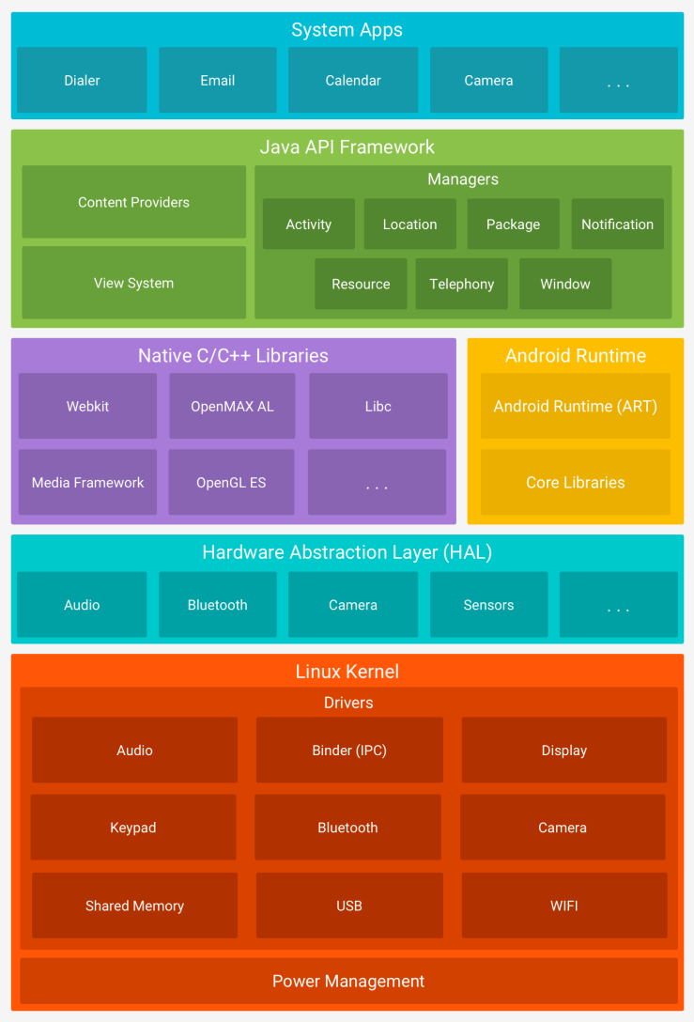
PLATFORM ARCHITECTURE
MADE BY: MOHIT && RAHUL

Slide 5
Application Building Blocks
• Activity
• Intent Receiver
• Service
• Content Provider
MADE BY: MOHIT && RAHUL

Slide 6
Activities
• Typically correspond to one UI screen
• But, they can:
Be faceless
Be in a floating window
Return a value
MADE BY: MOHIT && RAHUL

Slide 7
IntentReceivers
• Components that respond to broadcast ‘Intents’
• Way to respond to external notification or alarms
• Apps can invent and broadcast their own Intent
MADE BY: MOHIT && RAHUL

Slide 8
Intents
• Think of Intents as a verb and object; a description of what you want done – E.g. VIEW, CALL, PLAY etc..
• System matches Intent with Activity that can best provide the service
• Activities and IntentReceivers describe what Intents they can service
MADE BY: MOHIT && RAHUL

Slide 9
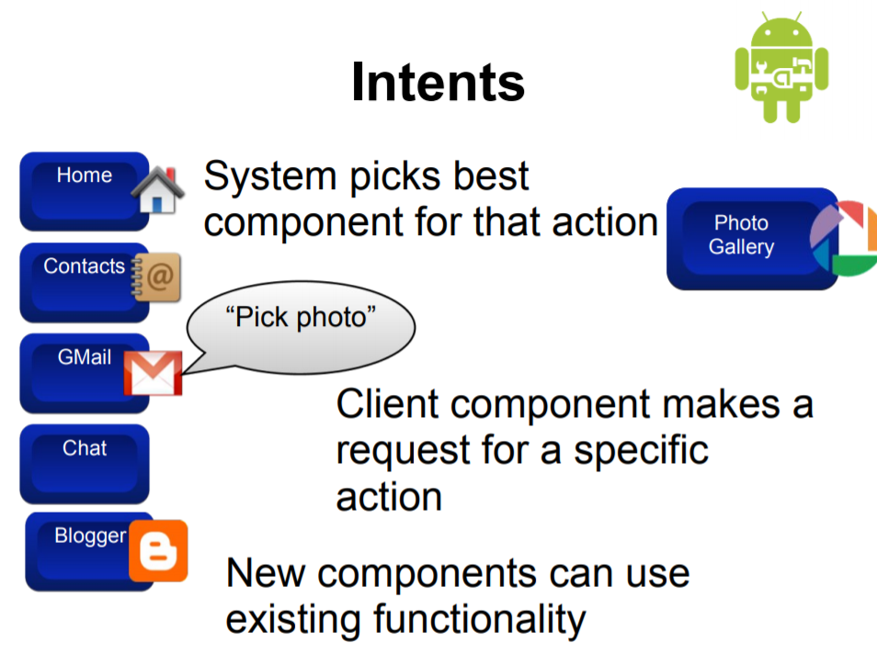
INTENTS…..
MADE BY: MOHIT && RAHUL

Slide 10
Services
• Faceless components that run in the background – E.g. music player, network download etc…
MADE BY: MOHIT && RAHUL

Slide 11
ContentProviders
• Enables sharing of data across applications – E.g. address book, photo gallery
• Provides uniform APIs for: – querying – delete, update and insert.
• Content is represented by URI and MIME type
MADE BY: MOHIT && RAHUL

Slide 12
VIEWS
TEXT \\ hi there or hello
IMAGE \\ any picture
BUTTON \\ submit button or radio button
MADE BY: MOHIT && RAHUL

Slide 13
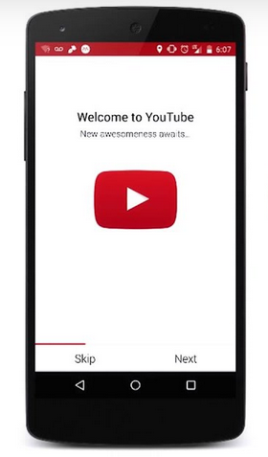
IDENTIFY VIEWS??
MADE BY: MOHIT && RAHUL

Slide 14
Solution
Text VIEW
IMAGE VIEW
BUTTON
MADE BY: MOHIT && RAHUL

Slide 15
XML SYNTAX
XML- Extensible MarkUp Language
It is a way to describe how your app is going to look.
We can use it to build layouts.
Have a look on material design website below.
https://material.io/design/color/#color-color-palette
Have a look at a Hexadecimal color codes
https://www.w3schools.com/colors/colors_hex.asp
LINK TO ONLINE XML VISUALIZER
https://labs.udacity.com/android-visualizer/#/android/
MADE BY: MOHIT && RAHUL

Slide 16
An Text View
<TextView
android:text="Hi there!"
android:layout_width="wrap_content"
android:layout_height="wrap_content"
android:background="#ccddff"
/>
READ MORE ON:
https://developer.android.com/reference/android/widget/TextView
MADE BY: MOHIT && RAHUL

Slide 17
ImageView
<ImageView
android:src="@drawable/cake"
android:layout_width="wrap_content"
android:layout_height="wrap_content"
android:scaleType="center"/>
LINK TO ALL THE TERMS(VOCABULARY GLOSSARY)
https://developers.google.com/android/for-all/vocab-words/?utm_source=udacity&utm_medium=course&utm_campaign=android_basics
MADE BY: MOHIT && RAHUL

Slide 18
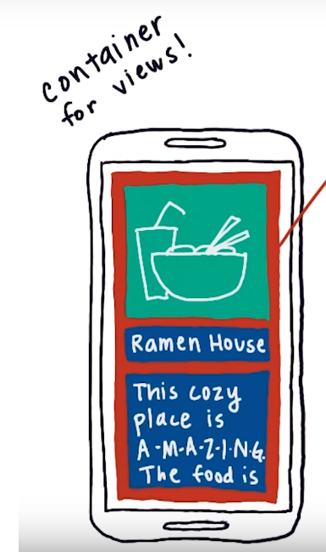
WHAT ARE VIEWGROUPS
For Holding More than one Views.
It is not visible to the users as it can be transparent.
Parent(ViewGroup)
Childs(View)
MADE BY: MOHIT && RAHUL

Slide 19
TYPES OF VIEWGROUP
1. LINEAR LAYOUT
Linear layout can arrange its children in a horizontal row or vertical column.
<LinearLayout
xmlns:android="http://schemas.android.com/apk/res/android"
android:orientation="vertical"
android:layout_width="wrap_content"
android:layout_height="wrap_content“
>
<TextView
android:text="Guest List"
android:layout_weight=“1”
android:layout_width="wrap_content"
android:layout_height="wrap_content"
android:textSize="24sp" />
<TextView
android:text=“Mohit"
android:layout_width="wrap_content"
android:layout_weight=“1”
android:layout_height="wrap_content"
android:textSize="24sp" />
</LinearLayout>
LINK TO LINEAR LAYOUTS
https://developer.android.com/reference/android/widget/LinearLayout
MADE BY: MOHIT && RAHUL

Slide 20
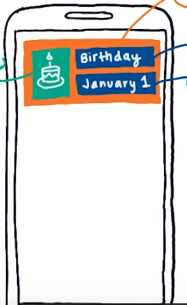
2. Relative Layout
It helps positioning children views relative to the parent view ex- top, bottom, center, top-right etc. to the parent.
It can also position
children relative
to other children
views.
Right of first child
3rd child below to 2nd ,
But right to 1st
MADE BY: MOHIT && RAHUL

Slide 21
LIST ITEM WITH RELATIVE LAYOUT
<LinearLayout
xmlns:android="http://schemas.android.com/apk/res/android"
android:layout_width="match_parent"
android:layout_height="match_parent"
android:orientation="vertical" >
<ImageView
android:layout_width="56dp"
android:layout_height="56dp"
android:scaleType="centerCrop"
android:src="@drawable/ocean" />
<TextView
android:layout_width="wrap_content"
android:layout_height="wrap_content"
android:text="Pebble Beach"
android:textAppearance="?android:textAppearanceMedium" />
<TextView
android:layout_width="wrap_content"
android:layout_height="wrap_content"
android:text="California"
android:textAppearance="?android:textAppearanceSmall" />
<TextView
android:layout_width="wrap_content"
android:layout_height="wrap_content"
android:text="10 miles away"
android:textAppearance="?android:textAppearanceSmall" />
</LinearLayout>
MADE BY: MOHIT && RAHUL

